Slide 1


SkillHub: Revolutionizing Education with AI-Powered Personalized Learning
Transforming education through dynamic curriculum and personalized learning paths.
-by
Hustlers.dev

Slide 2
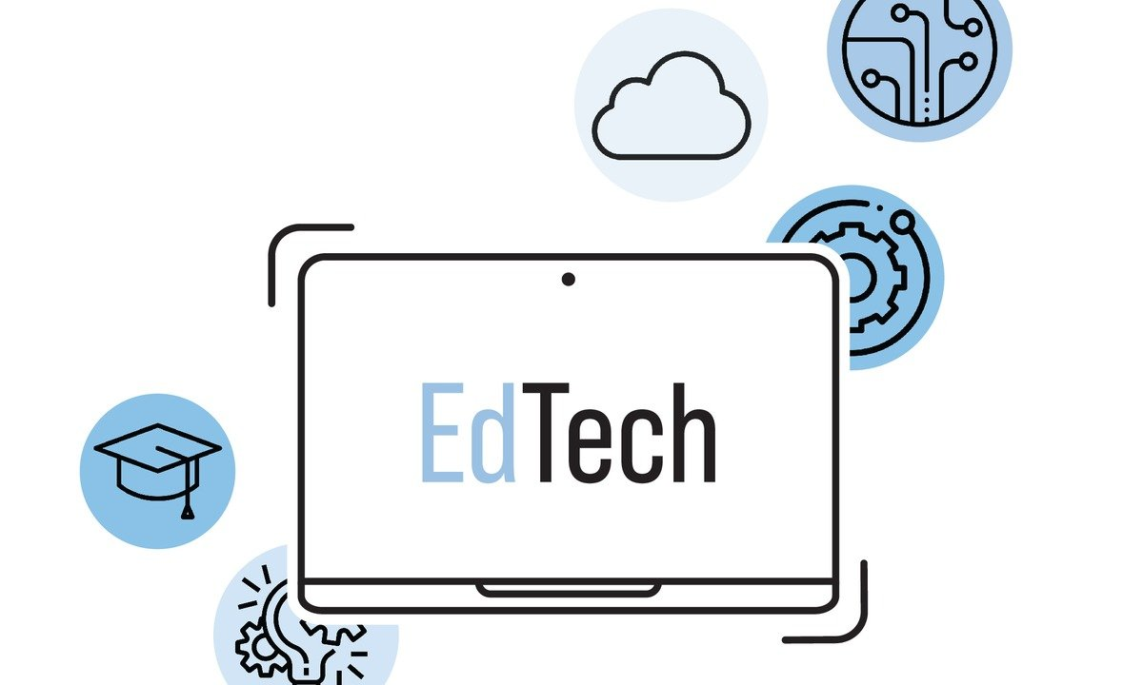

The Problem Statement: Ed - Tech
Develop a web-based learning platform that uses artificial intelligence to dynamically adjust curriculum delivery based on real-time student engagement and proficiency data. The system will use data from user interactions to personalize content, ensuring a tailored learning experience that helps educators pinpoint where students may be struggling and adjust the learning path accordingly.

Slide 3





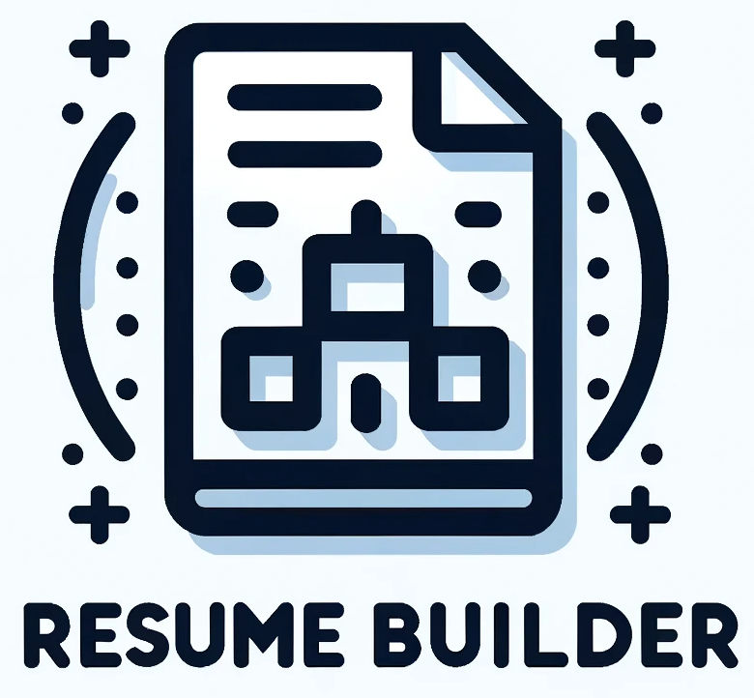

SkillHub: AI-Powered Personalized Learning Solution
Dynamic curriculum
Real-time data
Personalized experiences
Gamified learning
Resume Builder
Learn Genie

Slide 4
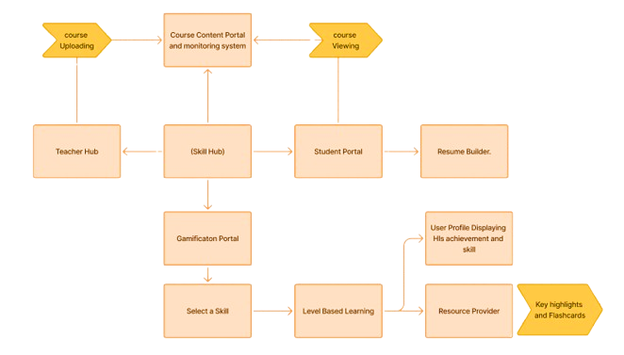
SkillHub Platform Architecture
Teacher Hub
Student Portal
Course creation and monitoring
Personalized learning dashboard
Skill Hub
Gamified skill progression

Slide 5




Teacher Dashboard: Empowering Educators
Content management
Upload and manage content
Real-time tracking
Track student progress
AI Analytics
Identify struggling students

Slide 6



LearnGenie: AI-Powered Video Learning
Key points extraction
Comprehensive summaries
Download the key points

Slide 7






Gamification & Skill Progression
Achievement badges
Earn rewards
Visualize skill
Level-based learning
Track progression
Clear milestones

Slide 8
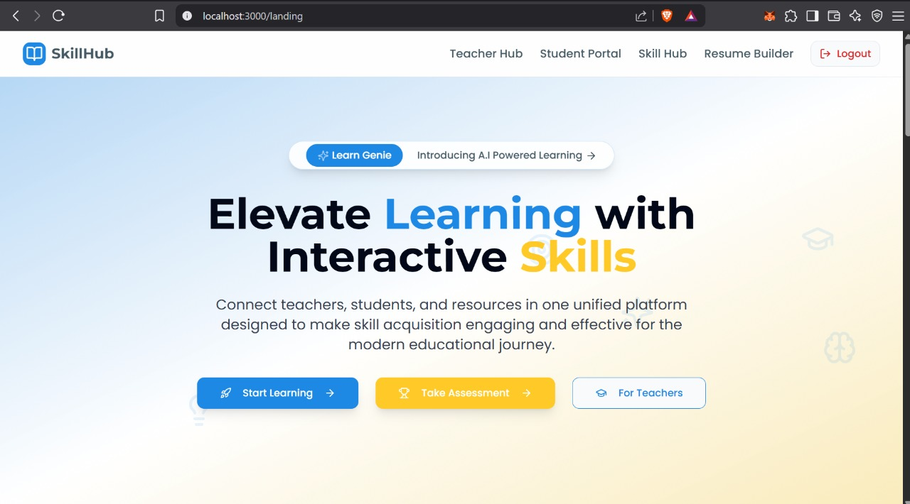
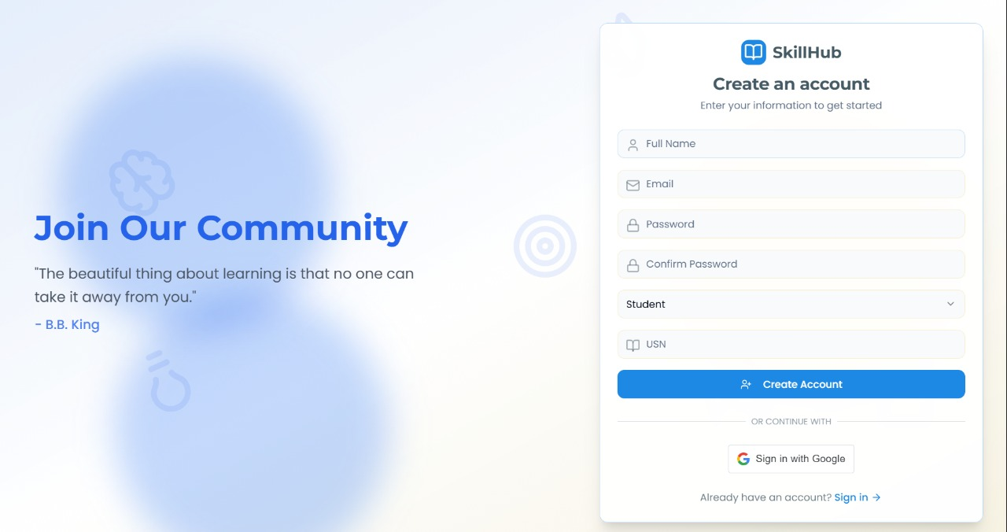

Results
Landing Page
Sign Up Page

Slide 9
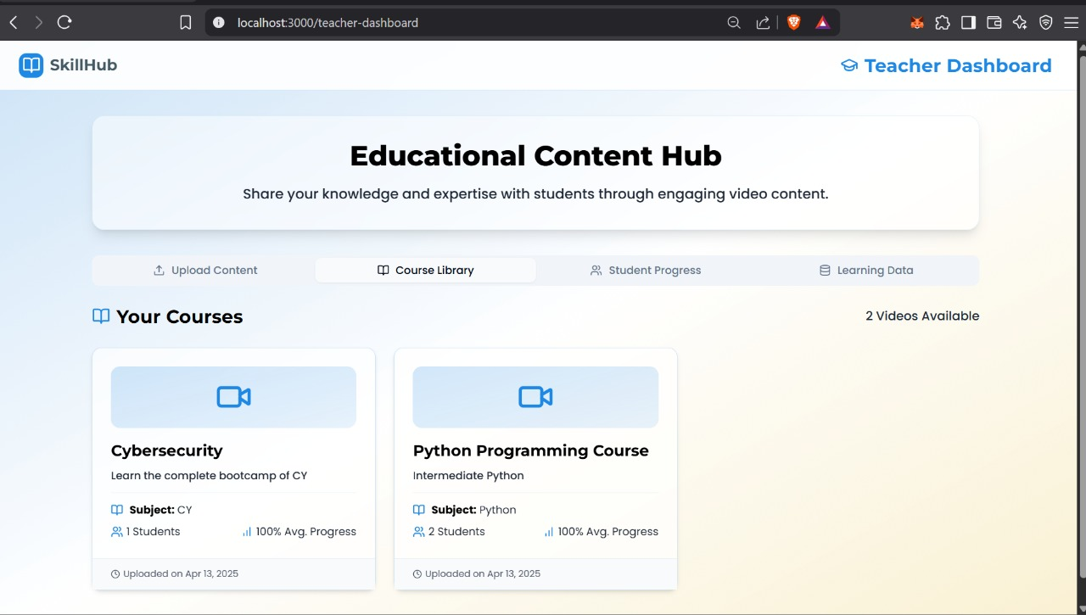
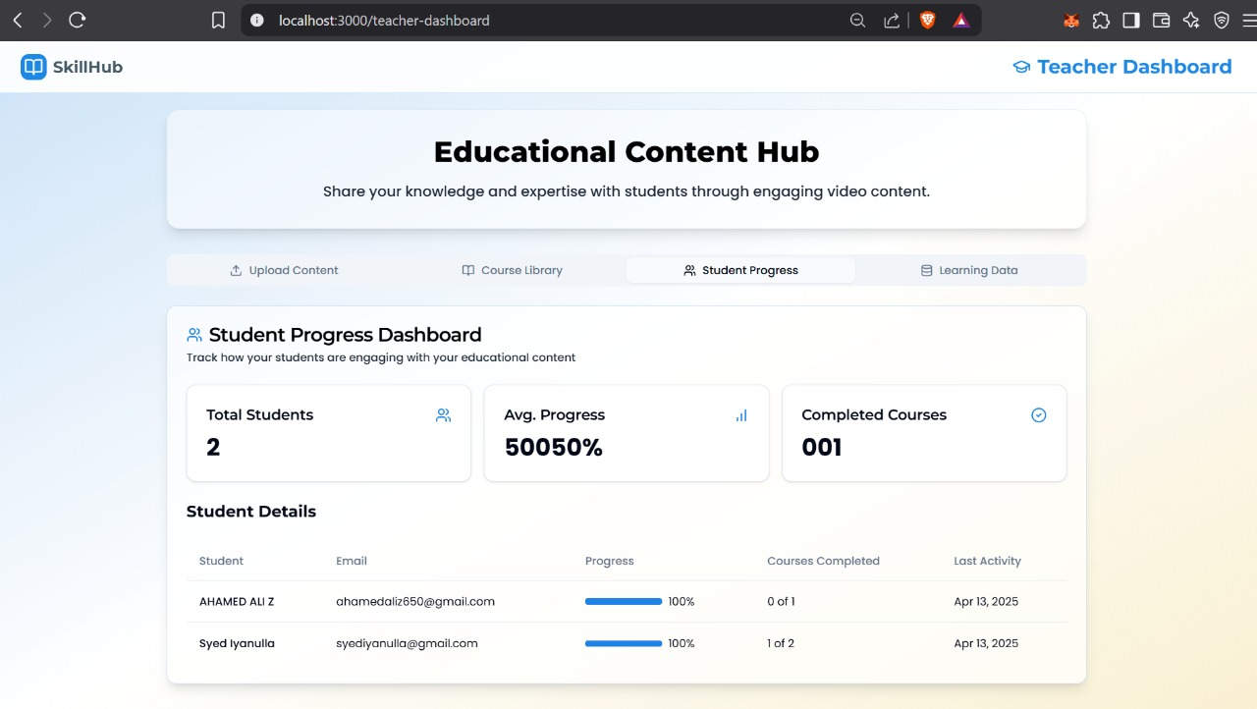
Results
Teacher’s Dashboard

Slide 10
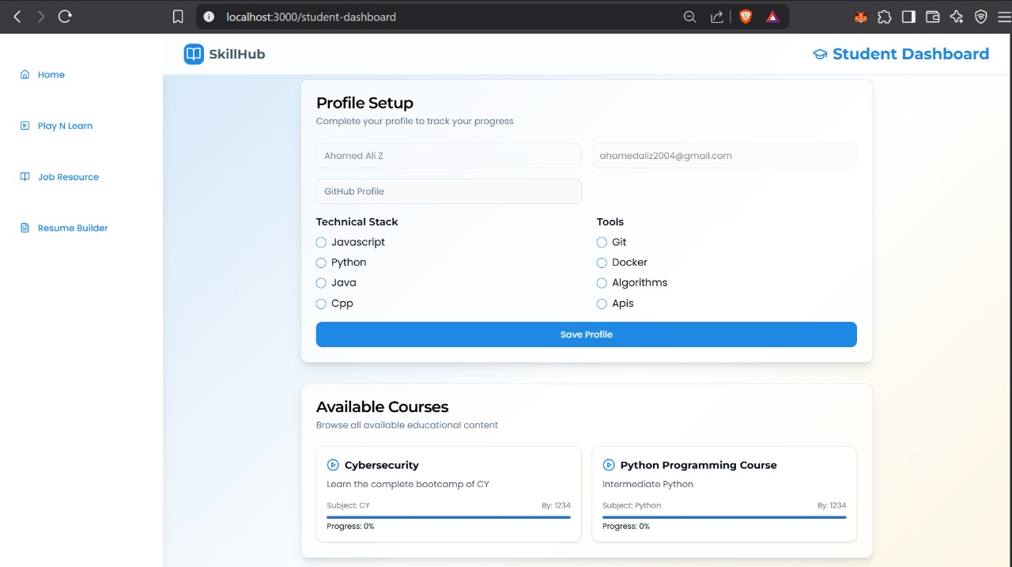
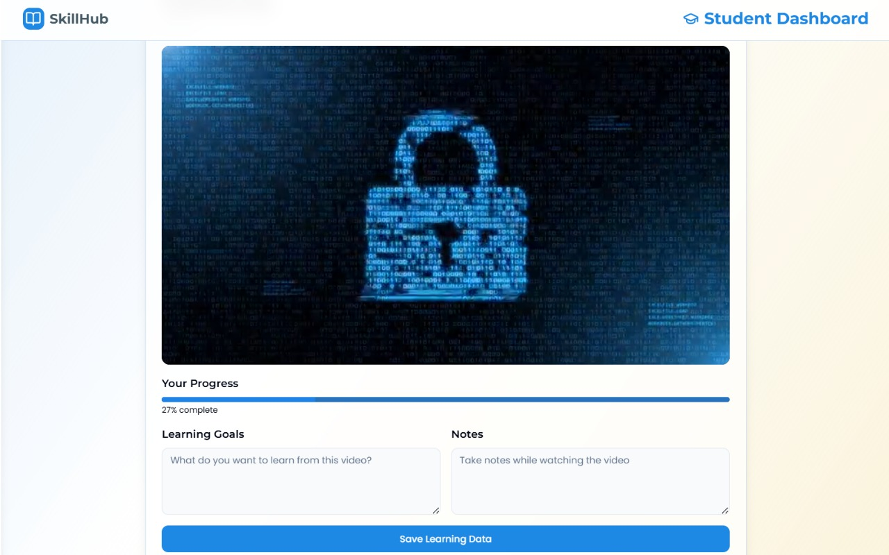
Results
Students
Dashboard

Slide 11
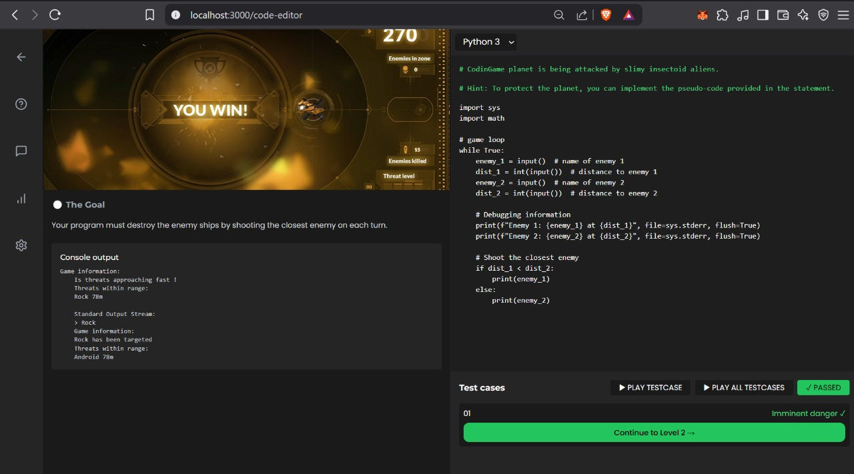
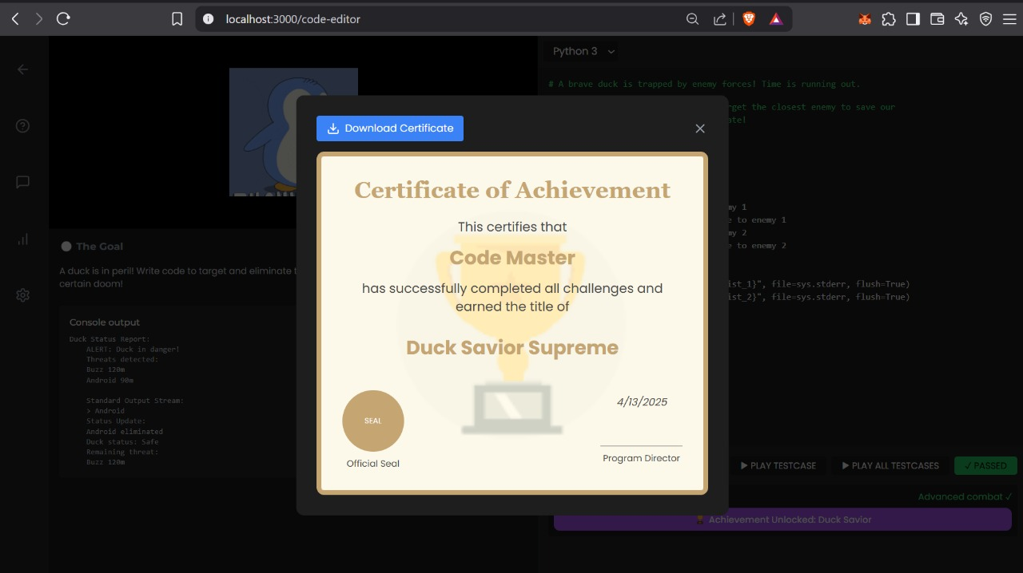
Results
Gamification Learning
Achievements

Slide 12
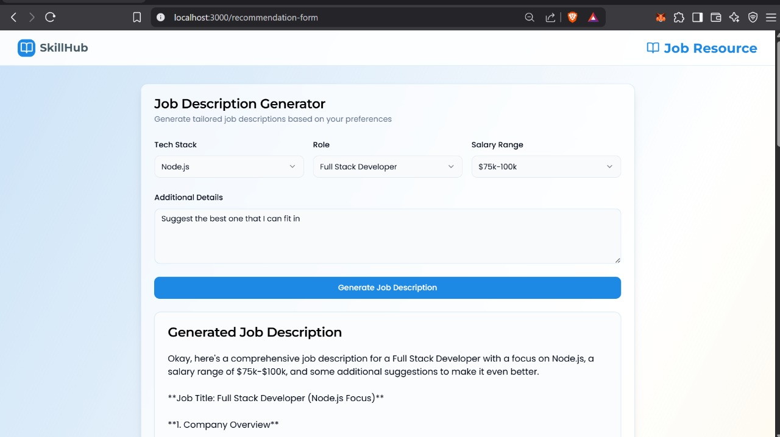
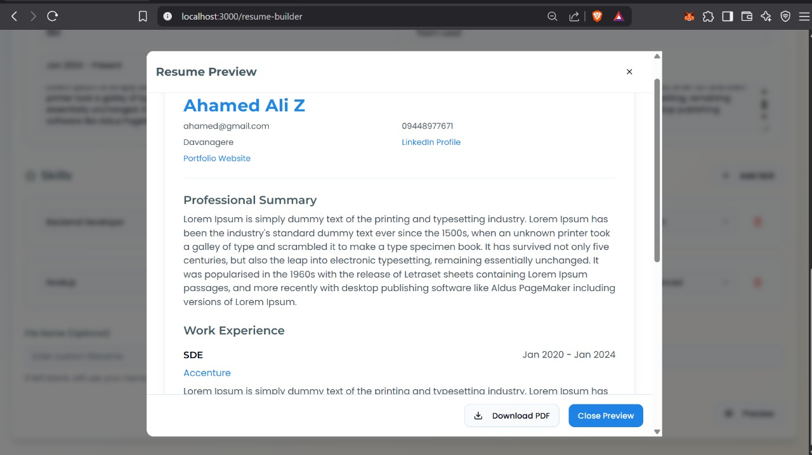
Results
Job Resource
Resume Builder

Slide 13
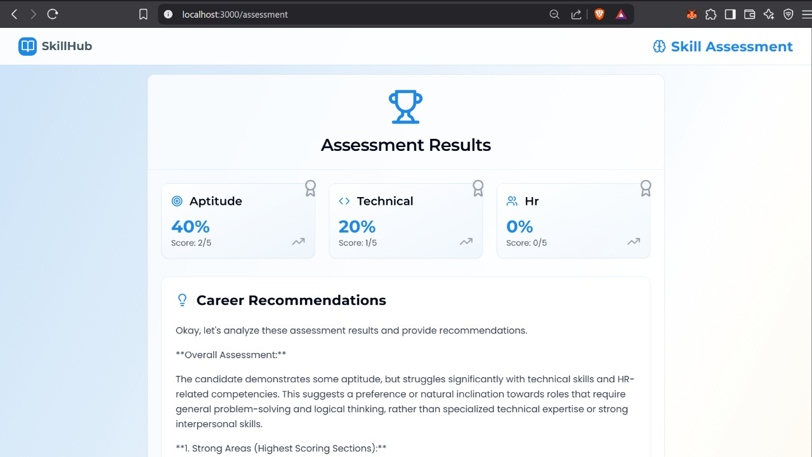
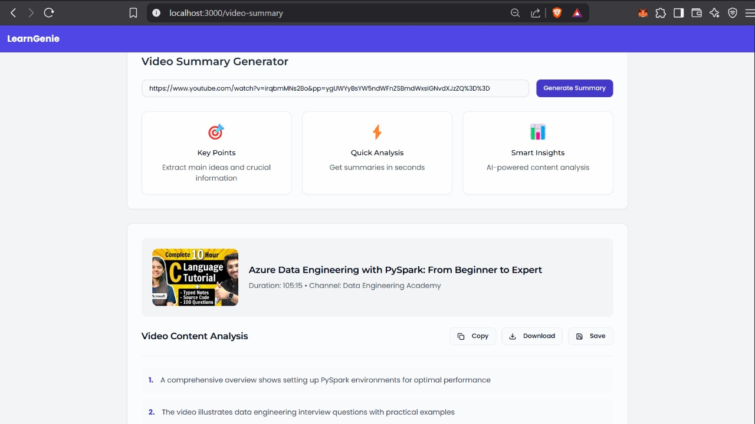
Results
Assessment Based learning
LearnGenie

